Slide 1
Active listening
Prepared by Dr. T. Sunand Emmanuel
2021-22 ECE-F, EEE, cse-a

Slide 2
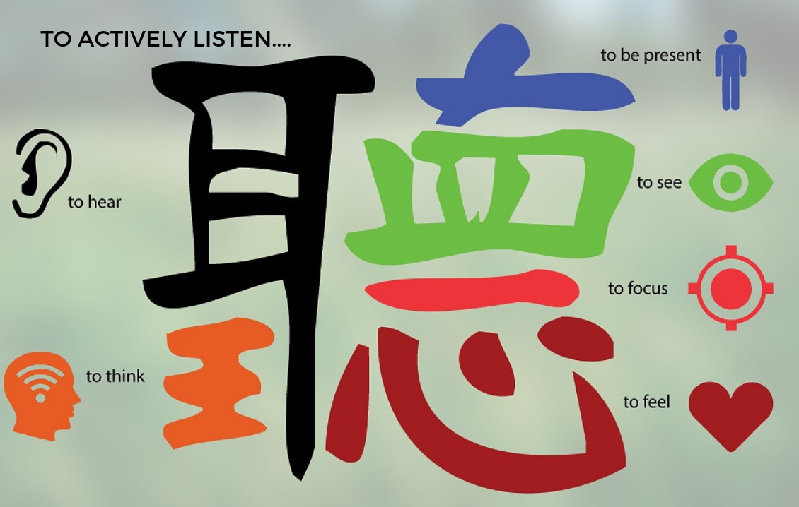
Chinese definition of listening

Slide 3
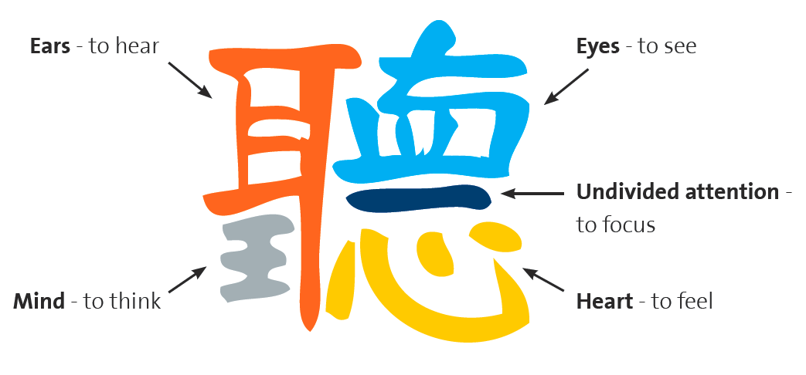

Slide 4
International Listening Association (ILA)
ACTIVE LISTENING
In 1996 the International Listening Association (ILA) approved the following definition: Listening: the process of receiving, constructing meaning from, and responding to spoken and/or nonverbal messages (Purdy & Borisoff, 1997:6).

Slide 5
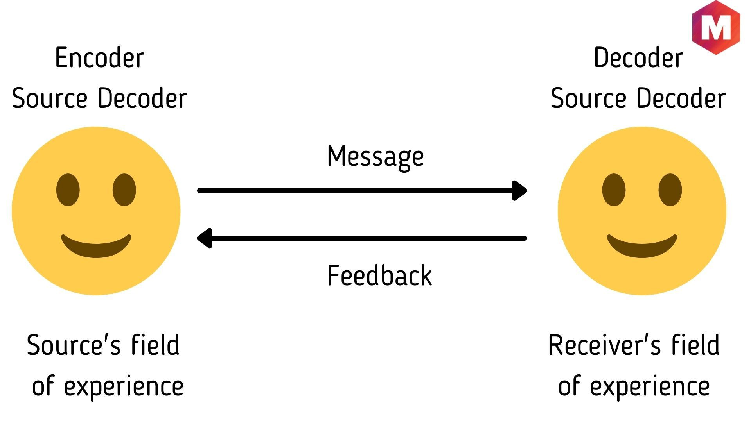
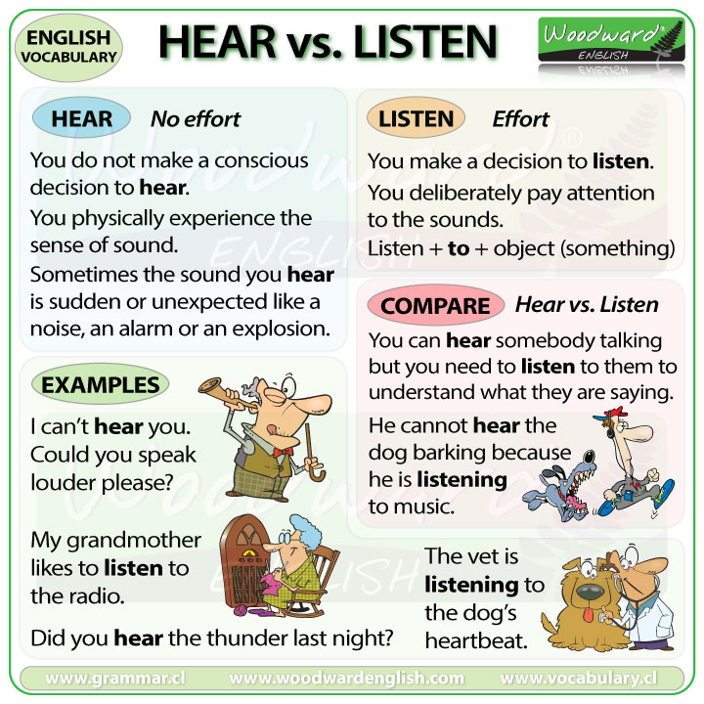
Hearing versus listening

Slide 6
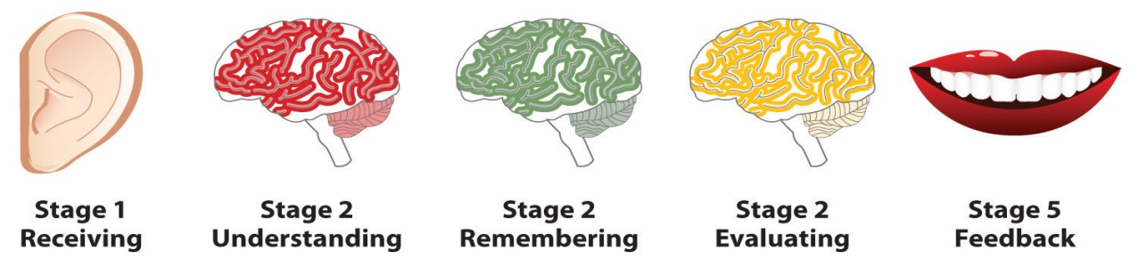
STEPS IN THE LISTENING PROCESS

Slide 7
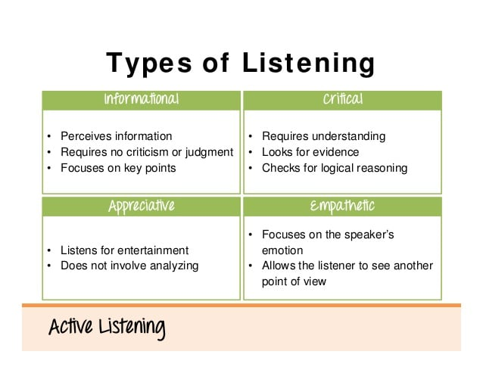
TYPES OF LISTENING

Slide 8
TYPES OF LISTENING
Comprehension---to gain knowledge, facts
Biased—what we generally like
Critical listening—to judge, assess truth
Appreciative—Listening to music
Empathetic– Putting ourselves in another person’s situation.

Slide 9
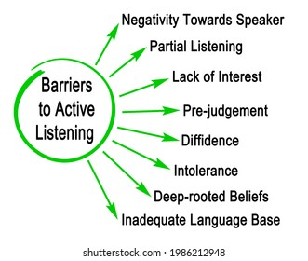
BARRIERS TO LISTENING

Slide 10
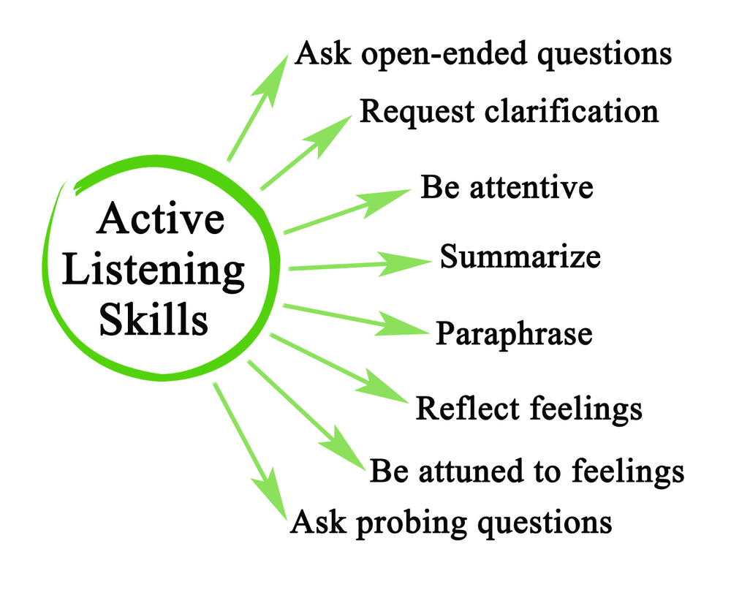
STEPS OF EFFECTIVE ACTIVE LISTENING

Slide 11
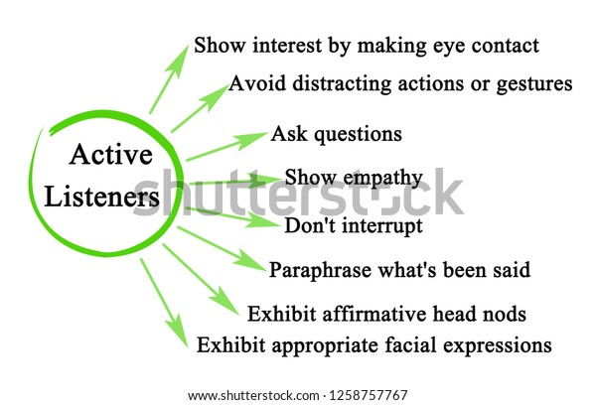

Slide 12
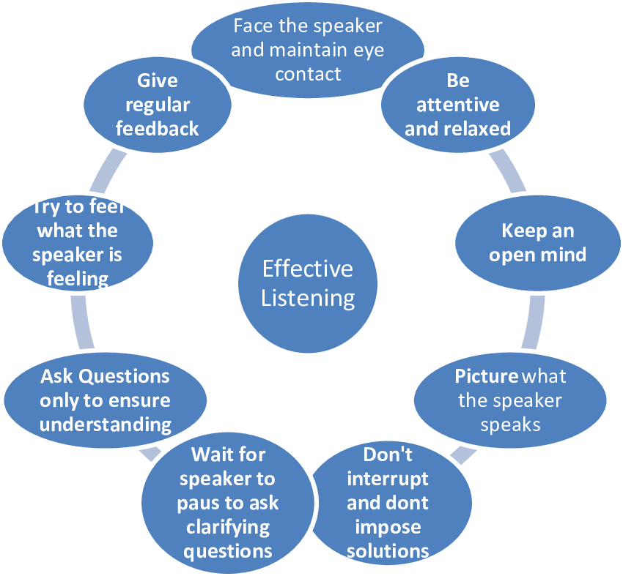
How to improve our listening skills

Slide 13
References
https://careers-in-sport.co.uk/career-advice/developing-effective-listening-skills/
https://www.shutterstock.com/image-illustration/eight-barriers-active-listening-1986212948
https://www.shutterstock.com/image-illustration/characteristics-active-listeners-1258757767
https://hildakweisburg.com/2018/08/11/on-libraries-build-your-listening-skills/
https://www.pinterest.com/pin/451485931380213512/

Slide 14
Thank you

